Slide 1


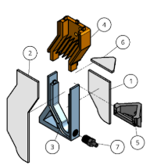
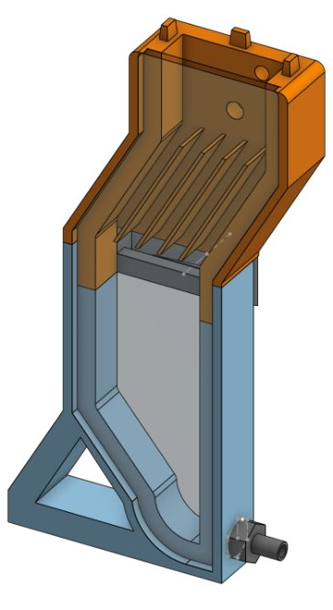

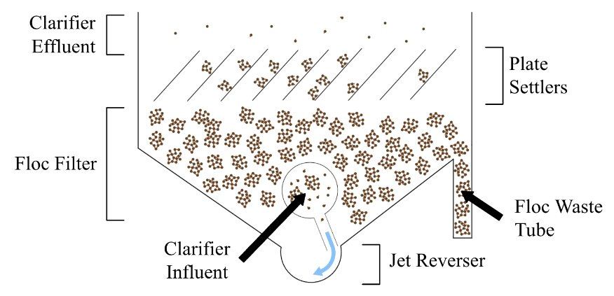
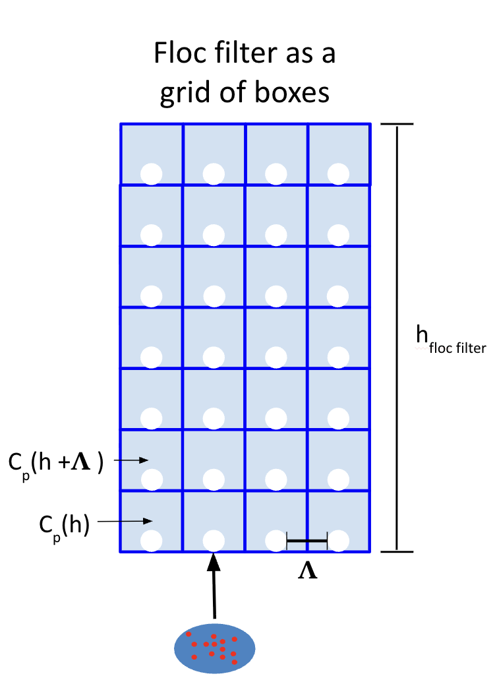
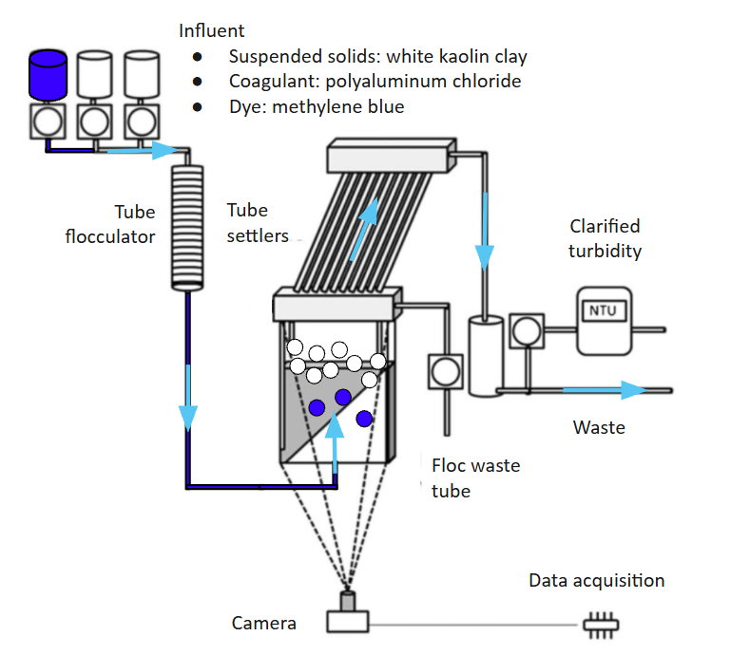
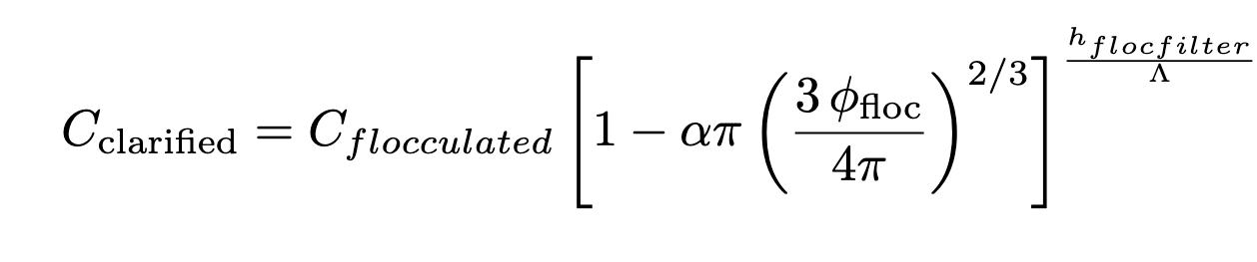
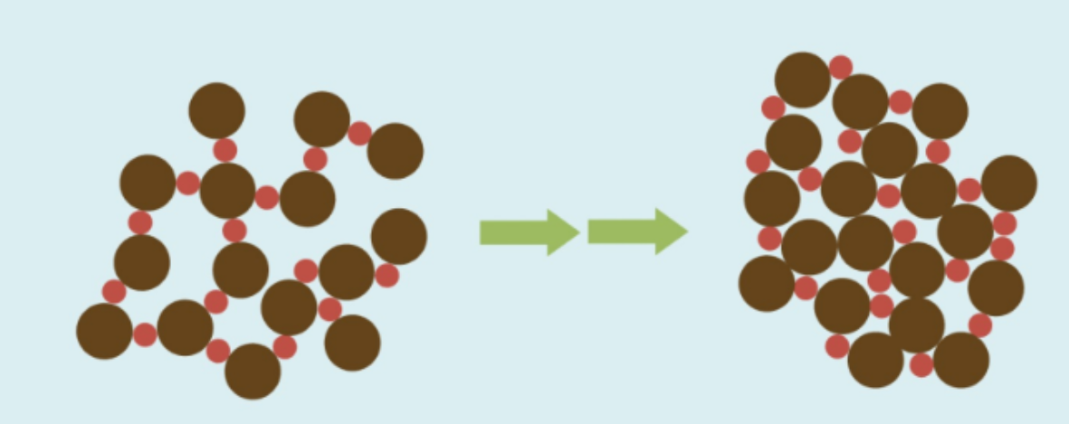
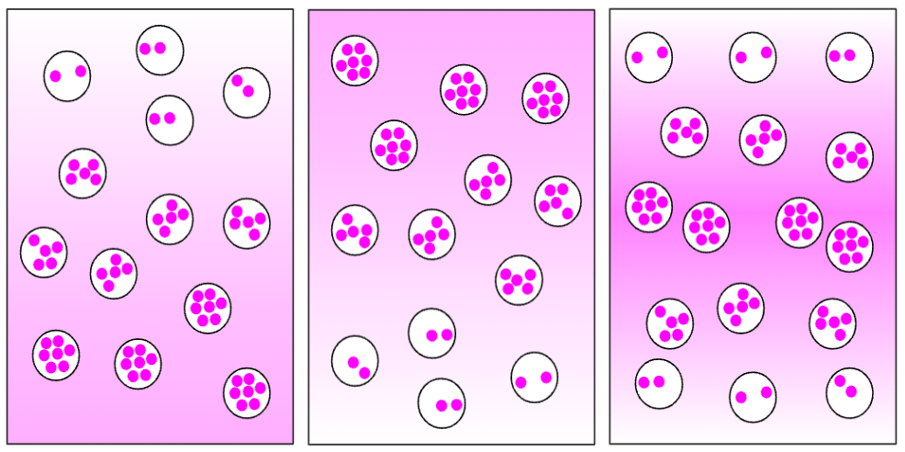
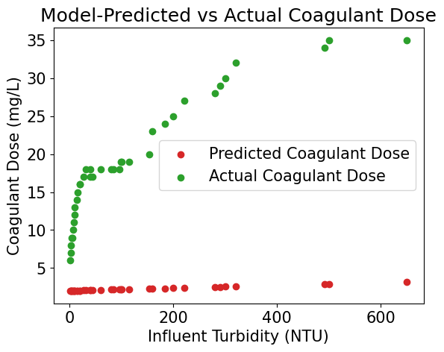
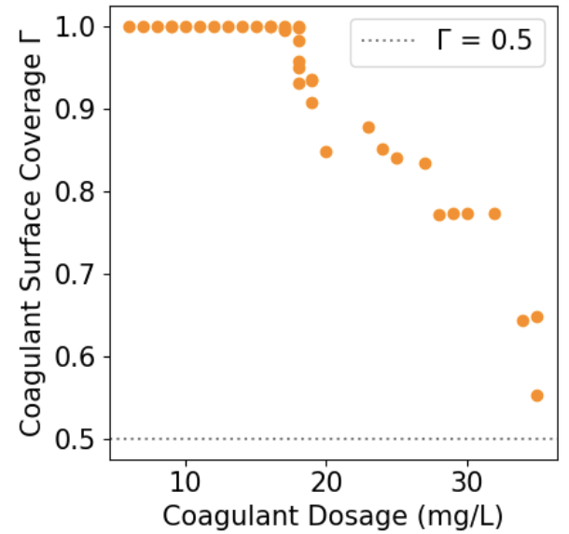
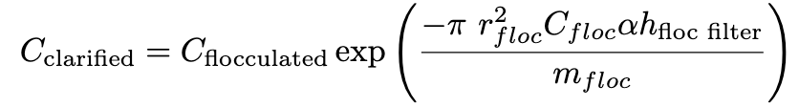
Floc Modeling: Floc Filter Clarification
Alex Gardocki, Lauren Hsu, Sarvesh Prabhu, Aaron Gu, Aronya Sarker, Irene Ma, Monroe Weber-Shirk
AguaClara Cornell, Civil and Environmental Engineering, Cornell University
Abstract
Clarification Modeling
Experimentation
Discussion
Creating an accurate model of floc filter clarification is crucial to optimizing the performance and chemical dosing of AguaClara treatment plants. This semester, we focused on theoretical work to correct errors in the model derivation and incorporate more complex mechanisms. We also prepared to conduct experiments using a bench-scale setup which will allow us to learn more about floc filter characteristics, like the spatial distribution of floc saturation, which can be incorporated into the model.
Coupled Flocculation-Sedimentation Model^{[3]}
A simple model for clarification can be obtained by fitting the clarification constant k in the AguaClara flocculation model^{[1]} to an exponential function related to the characteristics of the clarifier. By combining information about the clarifier’s settling velocity with a fitted parameter describing the particle size distribution after flocculation, the clarification constant k can be obtained for varying clarifier designs to accurately predict clarification performance. The model is shown below, where C_{p} is the clarified primary particle concentration and C_{P0} is the influent primary particle concentration.
This model only accounts for primary particle interactions with the plate settlers. A new approach is needed to account for floc filter clarification.
Discretized Floc Filter Clarification Model
To account for interactions with flocs in the floc filter, the floc filter was modeled as a grid of square boxes with side length equal to the floc separation distance Λ. Each box had a single floc located in the bottom center.
Using this template to predict primary particle-floc interactions led to the following equation.
C_{flocculated} can be obtained using the AguaClara flocculation model.
Taylor Series Approximation
Rewriting Equation 2 using a first-order Taylor series approximation yields Equation 3. This is equivalent to the Spring 2025 clarification model, which modeled the clarifier continuous rather than as discretized boxes.
Experimental Apparatus
Some changes were made to the mini clarifier this semester in preparation for experiments. A protruding lip was added to improve the adhesion of the front acrylic plate and the clarifier body. Additionally, the floc hopper floor was extended to slope downwards to prevent clogging. Sampling ports were removed due to difficulty in use and to avoid the possibility of leakage.
Figures 5, 6: Exploded view (left). Labeled parts include 1: acrylic back, 2: acrylic front, 3: clarifier bottom, 4: clarifier top, 5: floc hopper, 6: floc hopper acrylic, 7: jet inlet. Revised mini clarifier (right).
Experiment Design
A bench-scale flocculation and clarification setup (Fig. 6) will be used to visualize floc filter dynamics. A helical tube flocculator will be used to form uncolored flocs. Afterwards, flocs dyed with methylene blue dyed flocs will be added to the clarifier as tracers to test for uniformity of the floc filter.
The extremely low predicted dosage appears to be the result of the model calculating extremely high coagulant coverage at all given datapoints, as shown in Figure 7. This previously went unnoticed in part due to a mistake in the calculation for a coefficient relating the coagulant dosage to coagulant coverage. While the new calculation is consistent with other work in the literature^{[4]}, the resulting coagulant coverage in un-physical.
One explanation is that the model needs to account for coagulant that was added to the influent but remained in solution rather than adhering to the primary particles. If a large amount of coagulant remains in solution, this could significantly reduce the coagulant coverage of both the initial primary particles and the flocs in the floc filter.
Additionally, the close relation between the discretized and continuous clarification models indicates that both models are nearly interchangeable. This may have implications for the implementation of automated coagulant dosing, where one model may be less computationally intensive.
Introduction
Floc Filter Clarification
Clarification is the process of removing suspended solids from water, following flocculation.
AguaClara plants use lamella clarifiers, which have parallel plate settlers to maximize the surface area where particles can settle, and a floc filter, which uses suspended flocs to filter out smaller particles. This filtering process is called floc sweeping.
Figure 1. AguaClara clarifier diagram.
Coagulant
Coagulants neutralize particle charges to enable floc formation. Underdosing leads to poor aggregation and high effluent turbidity, while overdosing leads to charge reversal, increased sludge, and higher costs. Therefore, accurately modeling clarifier performance to determine the correct coagulant doses is crucial for efficient particle removal and in minimizing cost and treatment time.
Floc Saturation
Floc saturation describes how full a floc is as it captures primary particles. As pores fill, flocs become less effective at capturing additional particles, which decreases sweeping efficiency.
Figure 2. (left) An unsaturated floc vs. a saturated floc.
Figure 3. (right) Possible floc saturation spatial distributions.
Floc saturation depends on coagulant dose and floc filter conditions. As it may vary spatially in the clarifier, modeling its distribution can help identify and remove the most saturated flocs first to improve treatment efficiency.
Equation 1: Coupled Flocculation-Sedimentation model.
Future Work
Floc Saturation
Conduct jar tests using methylene blue–dyed flocs to evalutate floc saturation distribution
Clarification Modeling
Modify model to account for extremely high coagulant coverage, possibly by introducing charge repulsion or assuming some fraction of coagulant remains in suspension
Fit updated models to real-world operational data from AguaClara plant operators with the help of POST in order to validate the model and improve model parameters
References
Figure 4: Floc filter divided into boxes with primary particles entering from the bottom.
[1] Hurst, M., Weber-Shirk, M., Charles, P., & Lion, L. W. (2014). Apparatus for observation and analysis of Floc Blanket Formation and performance. Journal of Environmental Engineering, 140(1), 11–20. https://doi.org/10.1061/(asce)ee.1943-7870.0000773
[2] Pennock, W. H., Weber-Shirk, M. L., & Lion, L. W. (2018). A hydrodynamic and surface coverage model capable of predicting settled effluent turbidity subsequent to hydraulic flocculation. Environmental Engineering Science, 35(12), 1273–1285. https://doi.org/10.1089/ees.2017.0332
[3] Pennock, W. H., Lion, L. W., & Weber-Shirk, M. L. (2023). Simple model for coupled hydraulic flocculation-sedimentation performance. Journal of Environmental Engineering, 149(12). https://doi.org/10.1061/joeedu.eeeng-7384
[4] Swetland, K. A., Weber-Shirk, M. L., & Lion, L. W. (2014). Flocculation-sedimentation performance model for laminar-flow hydraulic flocculation with polyaluminum chloride and aluminum sulfate coagulants. Journal of Environmental Engineering, 140(3). https://doi.org/10.1061/(asce)ee.1943-7870.0000814
Figure 7: Experimental setup.
Results
Using coagulant dosage and influent turbidity data from an AguaClara plant in Nicaragua, the parameters for the revised floc filter clarification model were fitted, and the predicted coagulant dosages were graphed. However, the model severely underestimated the actual coagulant dosage.
Equation 2: Discretized floc filter clarification model.
Acknowledgements
Thank you to AguaClara Reach, Agua Para el Pueblo, AguaClara Cornell, Cornell Engineering, Cornell Project Teams, Andrew Pennock, and Dr. Monroe Weber-Shirk.
Equation 3: Taylor series approximation of Equation 2. This matches the Spring 2025 Clarification model.
Figures 8, 9: Graph of fitted model vs actual data (left). Coagulant surface coverage as coagulant dose and influent turbidity increase (right).
Contact: Alex Gardocki – rag325@cornell.edu

